Slide 1
Project 7 Supervised Machine Learning
Angela Salgado
Damian Borsiak

Slide 2
Objective
Based on received data set - compare several analytical models, to predict if company will be bankrupt or not

Slide 3
Plan of presentation
01
Time Tracking
Content
02
Data Cleaning
03
Features selection
04
Models description and implementation
05
Hyperparameters Tuning
06
Challenges
07
Conclusions
08
Q&A

Slide 4
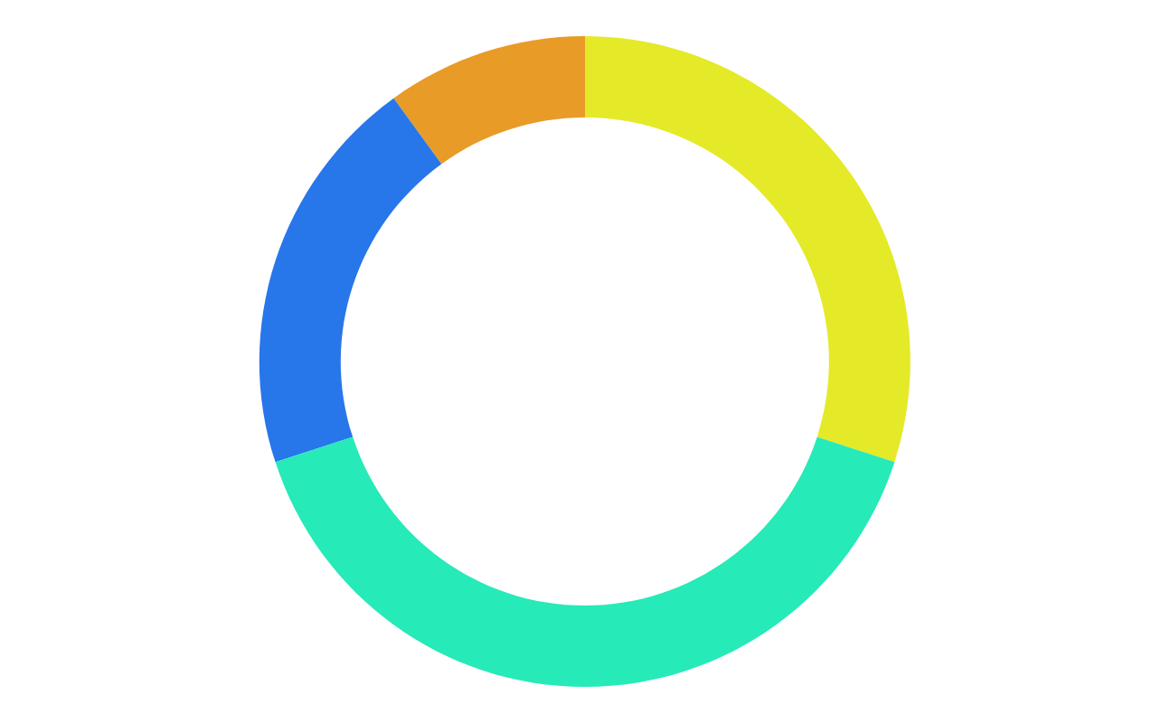
Time Tracking
2 hours
17 min
Data Cleaning
Hyperparameters Tuning
45 min
2 hours
Features Selection
AutoML (TPOT)
1 h 45 min
10 min
Models Implementation
Metrics comparison
Total time of work = @ 7 hours + ∞ time for presentation preparations :)

Slide 5
Data Cleaning
Before
After
Vs
96 features / columns of data
6819 rows
0 blanks
95 columns (1 dropped)
6819 rows
0 blanks

Slide 6
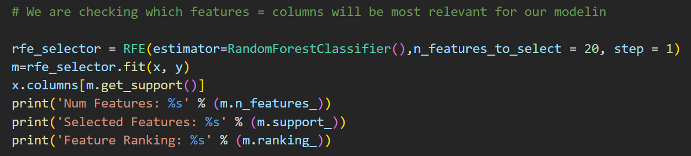
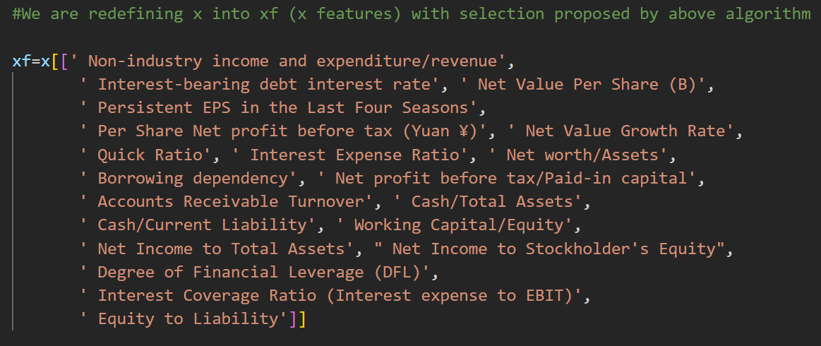
Features Selection

Slide 7
Models
01 | Logistic regression
02 | NuSVC
03 | BernoulliNB
04 | AdaBoostClassifier
05 | Linear Discriminant Analysis

Slide 8
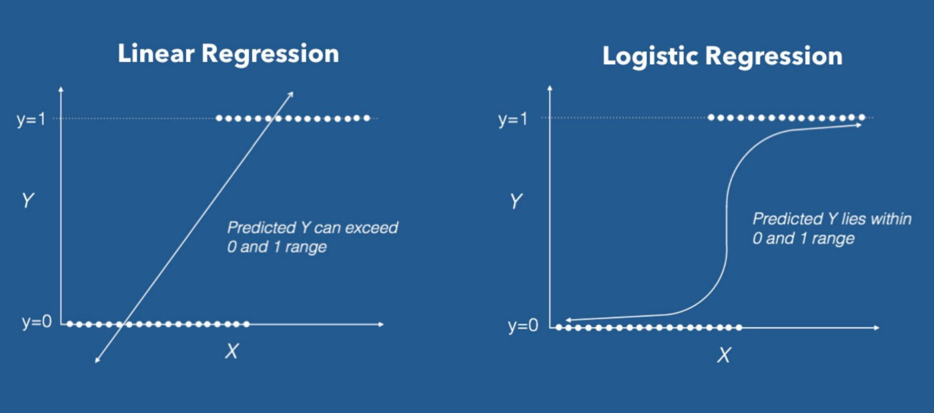
Logistic Regression Model

Slide 9
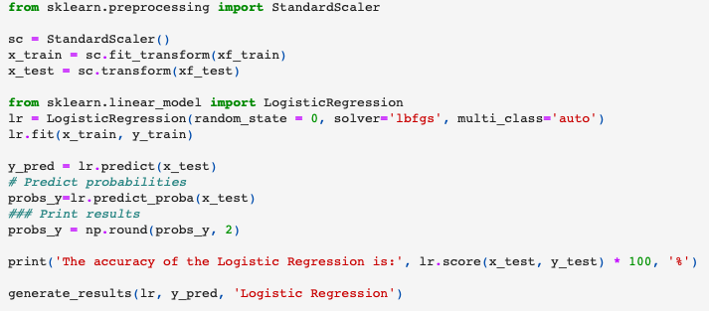

Slide 10
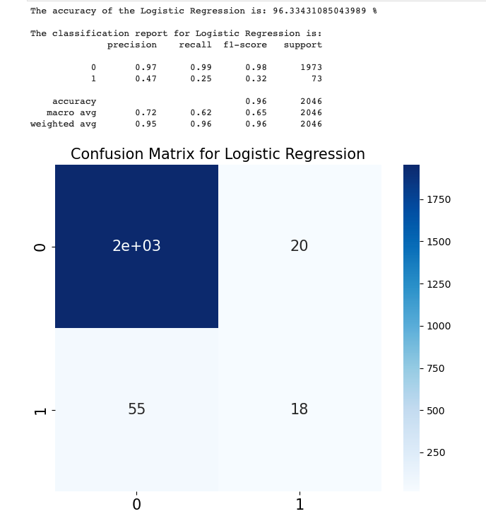
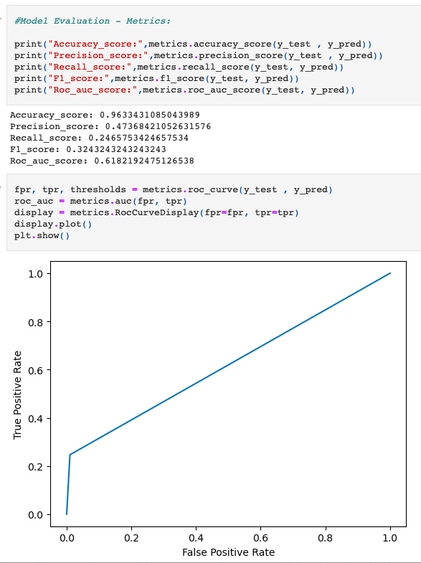

Slide 11
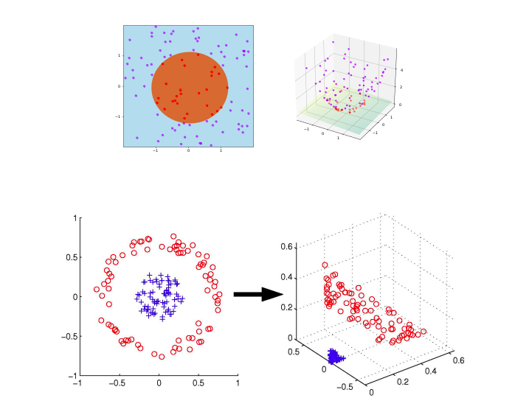
NuSVC Model
Separate non-linearly separable data. SVM aims to maximize this margin by mapping training points to a higher dimensional space where a linearly separating hyperplane can be found

Slide 12
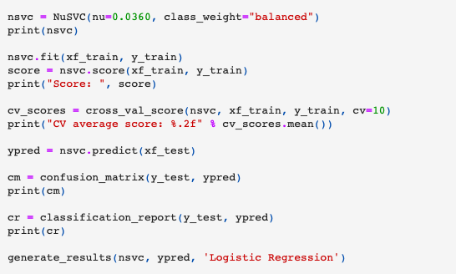

Slide 13
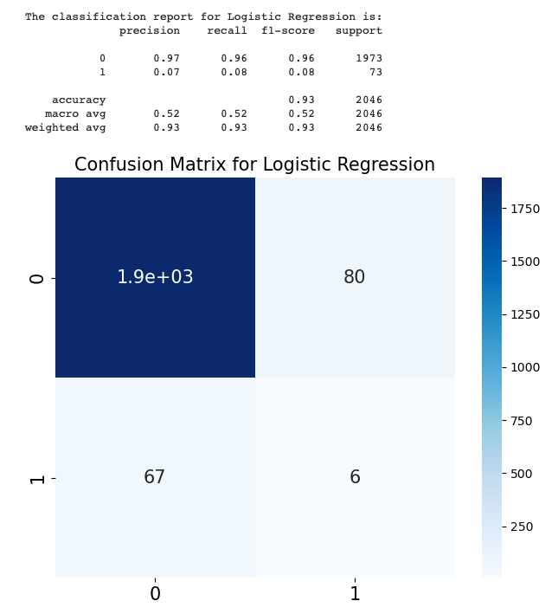
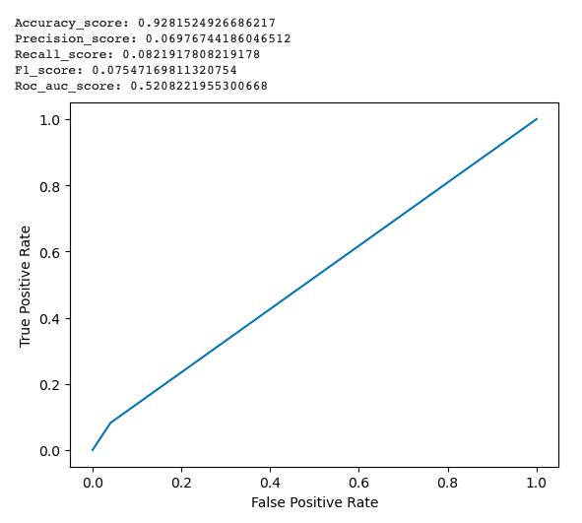

Slide 14
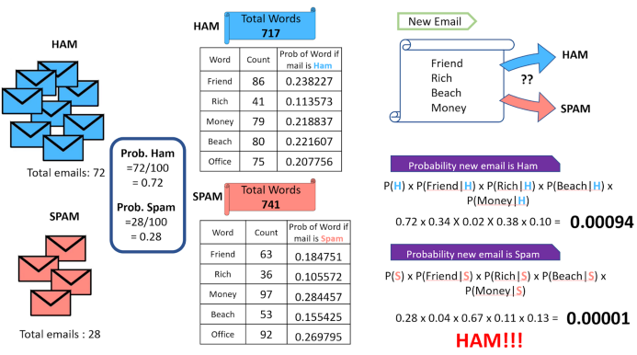
BernoulliNB / Bernoulli Naive Bayes / BNB

Slide 15
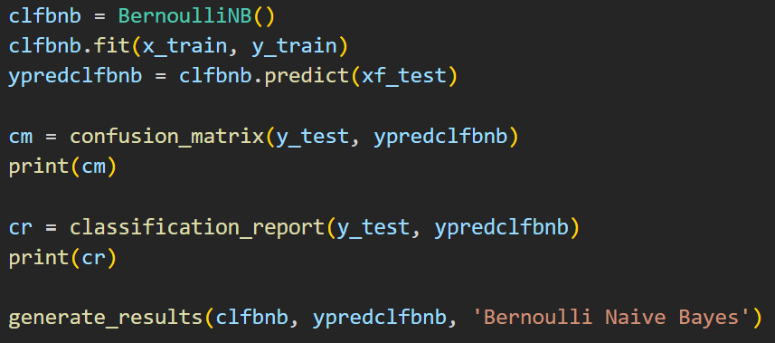

Slide 16
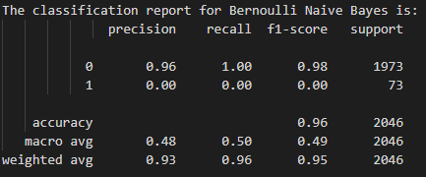
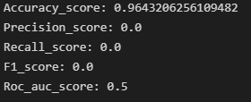
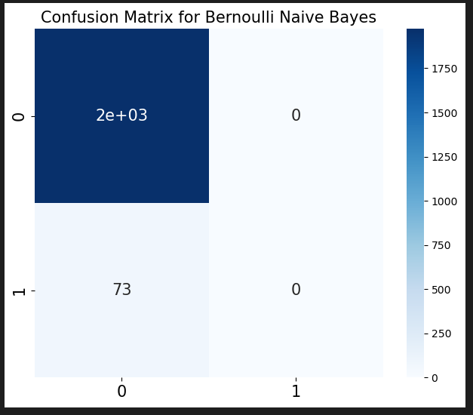
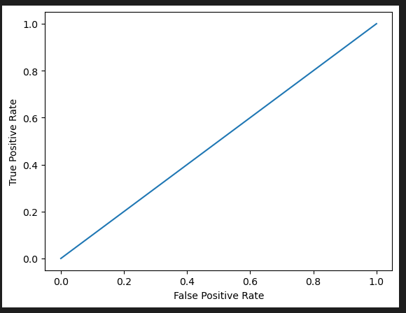

Slide 17
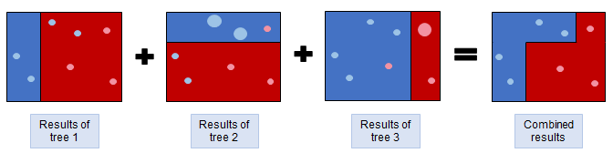
AdaBoost Classifier
Combining weak learners (decision trees)
Assigning weights to incorrect values
Sequential tree growing considering past mistakes

Slide 18
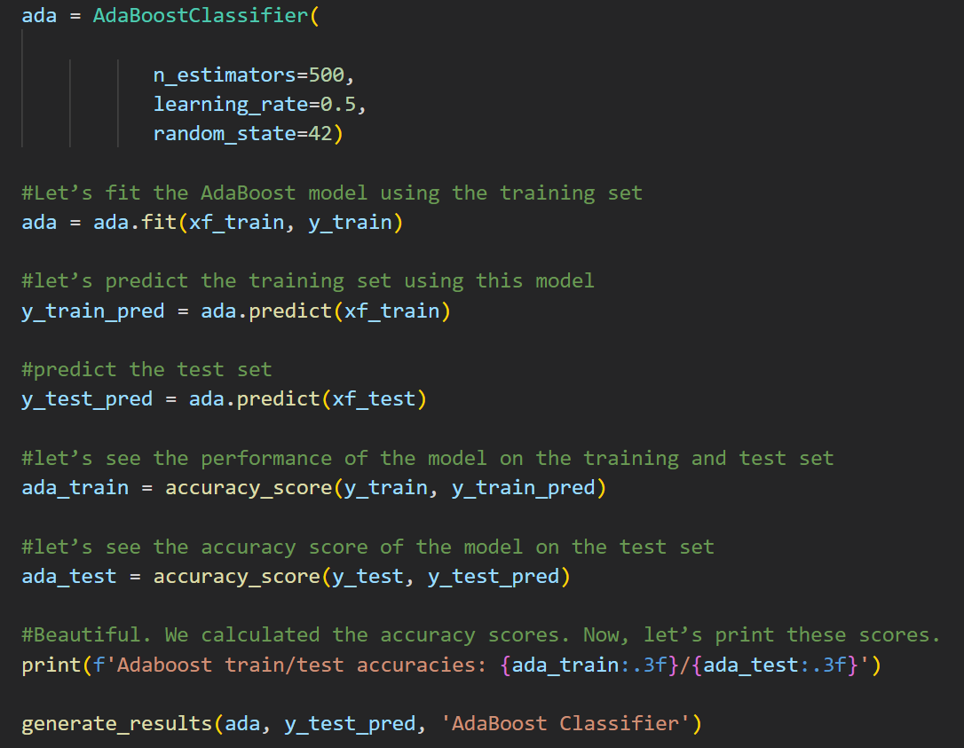

Slide 19
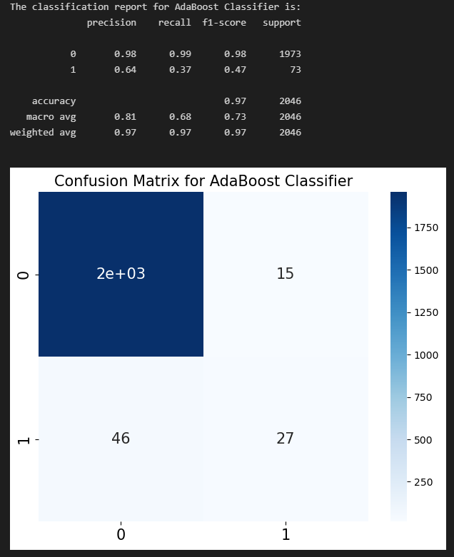
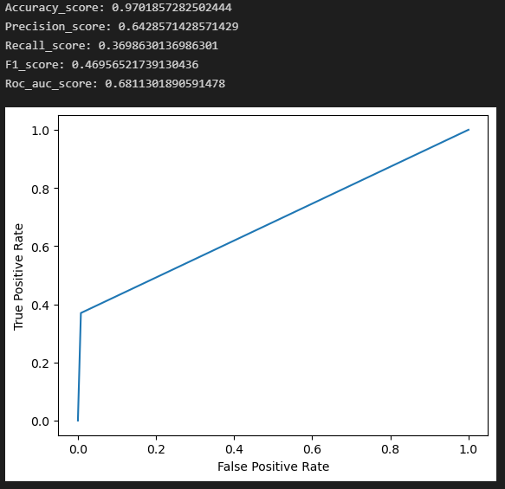

Slide 20
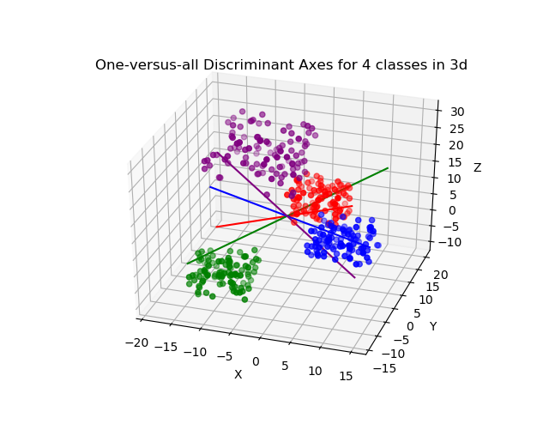
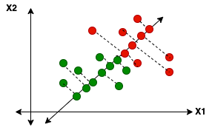
Linear Discriminant Analysis

Slide 21
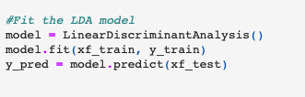

Slide 22
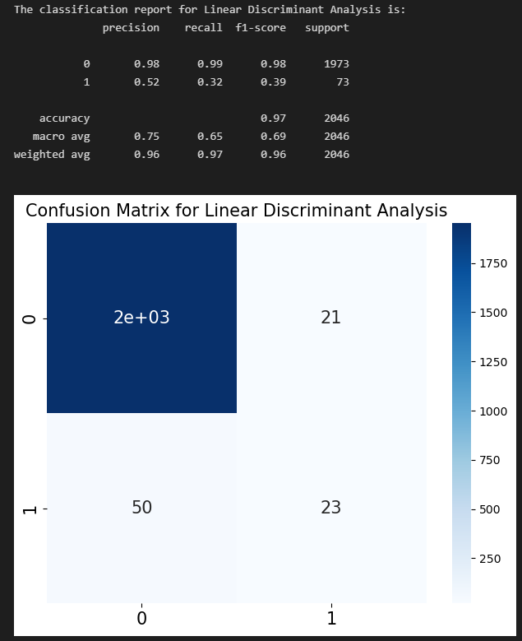
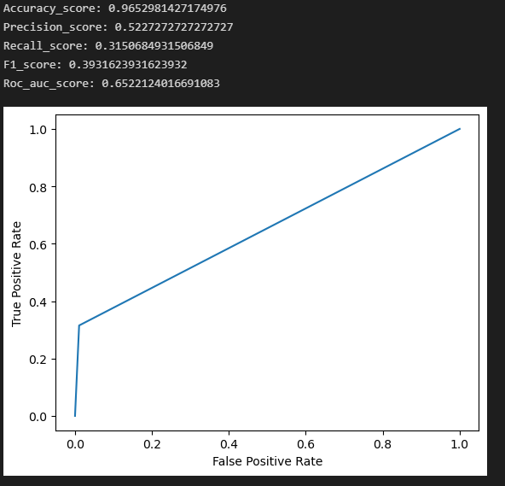

Slide 23
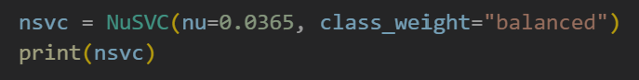
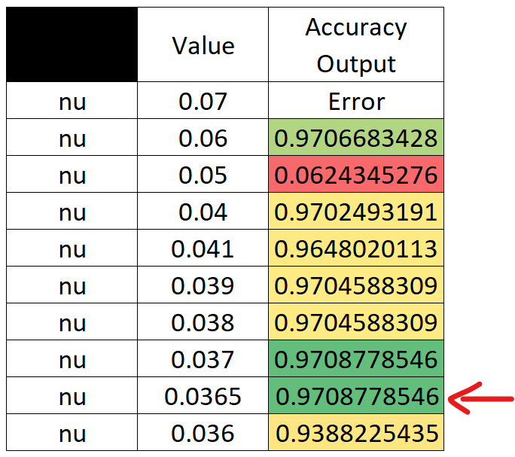
Hyperparameters Tuning of NuSVC

Slide 24
CHALLENGES
01
02
03
Features selection
Understanding the models
Adapting code to our data
04
05
Evaluation of models
Time consuming output / results

Slide 25
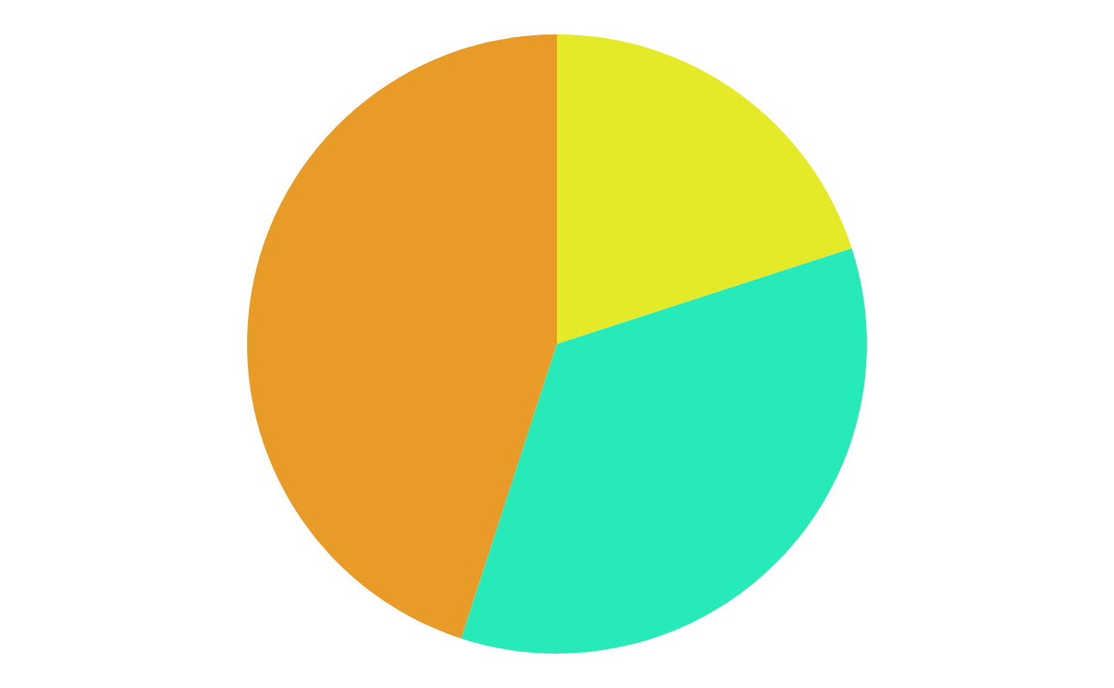
Conclusion
With a …
0,97 accuracy score..
AdaBoostClassifier is the best model for our data

Slide 26


Slide 29
Machine Learning Infographics
01
AI software
04
Compact the model
Venus has a beautiful name, but it’s hot
Despite being red, Mars is a cold place
02
Framework
Convert the model
05
Mercury is the closest planet to the Sun
Saturn is the only planet with rings
03
Train the model
06
Integrate the model
The Earth is the third planet from the Sun
Jupiter is the biggest planet of them all

Slide 30
Machine Learning Infographics
Artificial Intelligence
Machine learning
Vs
Computers act on their own
They act according to environment
Systems display cognitive ability
Computers make decisions
It’s an application of AI
Computers observe and analyze
Predict based on previous patterns
Pre-programmed algorithms

Slide 31
Machine Learning Infographics
Spam filtering
Mercury is the closest planet to the Sun
Some machine learning applications
Mobile banking
The Earth is the planet where we all live
Risk assessment
Despite being red, Mars is a cold place
Social networks
Jupiter is the biggest planet of them all

Slide 32
Machine Learning Infographics
01
02
Venus
Mercury
Venus has a beautiful name, but it’s hot
Mercury is the closest planet to the Sun

Slide 33
Machine Learning Infographics
01
02
Mercury
Venus
Mercury is the closest planet to the Sun
Machine learning
Venus has a beautiful name, but it’s hot
Yes, Saturn is a gas giant that has several rings
03
04
Earth
Mars
The Earth is the third planet from the Sun
Despite being red, Mars is a cold place

Slide 34
Machine Learning Infographics
Machine learning
Mars
04
Saturn is the gas giant that has rings
Despite being red, Mars is a cold place
Venus
03
Venus has a beautiful name, but it’s hot
Mercury
02
Mercury is the closest planet to the Sun
Earth
01
The Earth is the third planet from the Sun

Slide 35
Machine Learning Infographics
01
Power
AI
Memory
02
Mercury is the closest planet to the Sun
Neptune is the farthest planet from the Sun
System configuration
03
Memory
Mars
04
Jupiter is a gas giant and the biggest planet
Despite being red, Mars is a cold place
05
Security
FPGA
06
Venus has a beautiful name, but it’s hot
Pluto is considered a dwarf planet
07
MCU
Wireless
08
The Earth is the third planet from the Sun
Ceres is located in the main asteroid belt

Slide 36
Machine Learning Infographics
Artificial intelligence
Mercury is the closest planet to the Sun
Machine learning
Jupiter is a gas giant and the biggest planet
Deep learning
Venus has a beautiful name, but it’s hot

Slide 37
Machine Learning Infographics
Output unit
Neural network
Yes, Saturn is a gas giant that has rings
01
Output layer
02
Input layer
Input unit 1
Input unit 2

Slide 38
Machine Learning Infographics
01
02
03
04
1950s
1960s
1970s
1980s
Simple algorithms
Bayesian methods
AI winter caused by pessimism
Resurgence in ML research
Mercury is the closest planet to the Sun
Jupiter is a gas giant and the biggest planet
Venus has a beautiful name, but it’s very hot
Mercury is the closest planet to the Sun
05
06
07
1990s
2000s
2010s
Data-driven approach
Support-Vector Clustering
Deep learning popularity
The Earth is the third planet from the Sun
Ceres is located in the main asteroid belt
Venus has a beautiful name, but it’s very hot

Slide 39
Machine Learning Infographics
Continuous improvement
Machine learning disadvantages
01
Despite being red, Mars is a cold place
Data acquisition
02
Venus has a beautiful name, but it’s hot
Patterns identification
03
Mercury is the closest planet to the Sun
Time and resources
04
The Earth is the third planet from the Sun

Slide 40
Machine Learning Infographics
01
02
Image recognition
Customization
The Earth is the planet where we live
Despite being red, Mars is a cold place
03
04
Voice recognition
Opportunities of machine learning
Data analysis
Venus has a beautiful name, but it’s hot
The Earth is the third planet from the Sun
05
06
Optical recognition
Memory data
Mercury is the closest planet to the Sun
Pluto is considered a dwarf planet

Slide 41
Machine Learning Infographics
Machine learning
The model
Venus has a beautiful name, but it’s hot
Despite being red, Mars is a cold place
Input 1
Input 2
The Earth is the third planet from the Sun
Mercury is the closest planet to the Sun

Slide 42
Machine Learning Infographics
01 | Supervised learning
 | Venus has a beautiful name, but it’s hot
02 | Unsupervised learning
 | Despite being red, Mars is a cold place
03 | Semi-supervised learning
 | The Earth is the third planet from the Sun
04 | Reinforcement learning
 | Mercury is the closest planet to the Sun
05 | Dimensionality reduction
 | Pluto is considered a dwarf planet

Slide 43
Machine Learning Infographics
01
Active learning
Maturation
02
Mercury is the closest planet to the Sun
Jupiter is a gas giant and the biggest planet
03
Motor synergies
Imitation
04
The Earth is the planet where we live
Despite being red, Mars is a cold place

Slide 44
Machine Learning Infographics
45%
20%
Data mining
Intrusion detection
The Earth is the third planet from the Sun
Mercury is the closest planet to the Sun
35%
Continuous production
Despite being red, Mars is a very cold place
Follow the link in the graph to modify its data and then paste the new one here. For more info, click here

Slide 45
Machine Learning Infographics
01
Classify data
Mercury is the closest planet to the Sun
Machine learning objectives
02
Make predictions
The Earth is the planet where we live

Slide 46
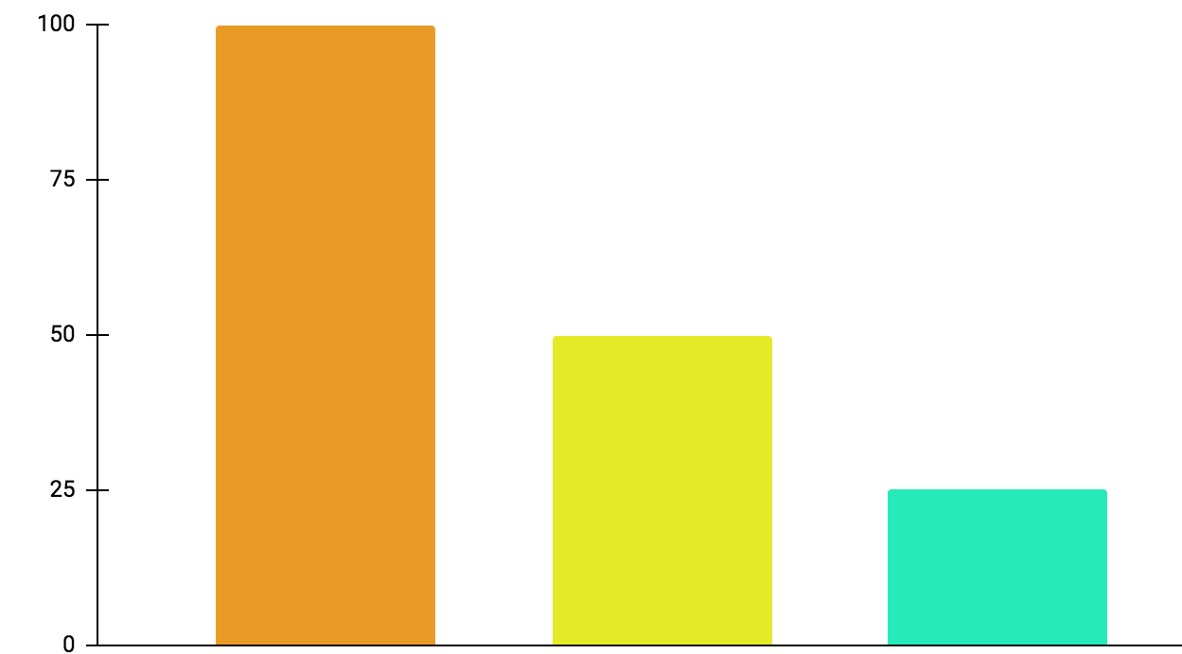
Machine Learning Infographics
01
Active learning
Mercury is the closest planet to the Sun
02
Maturation
Jupiter is a gas giant and the biggest planet
03
Motor synergies
Neptune is very far away from the Sun
100%
50%
25%
Follow the link in the graph to modify its data and then paste the new one here. For more info, click here

Slide 47
Machine Learning Infographics
Models
Artificial neural networks | The Earth is the planet we live on
Decision trees | Mercury is the smallest planet
Support-vector machines | Despite being red, Mars is a cold place
Regression analysis | Jupiter is the biggest planet of them all
Bayesian networks | Venus has a beautiful name
Genetic algorithms | Pluto is considered a dwarf planet

Slide 48
Machine Learning Infographics
Collect the data
Prepare the data
Mercury is the closest planet to the Sun
The Earth is the third planet from the Sun
Train a model
Despite being red, Mars is a cold place
Improve
Evaluate the model
Pluto is considered a dwarf planet
Jupiter is the biggest planet of them all

Slide 49
Machine Learning Infographics
Inputs
Outputs
Mercury is the closest planet to the Sun
Jupiter is a gas giant and the biggest planet
Input 1
Output 1
Input 2
Output 2
Input 3
Output 3

Slide 50
Machine Learning Infographics
Supervised learning
Unsupervised learning
Reinforcement learning
Classification
Reduction
Fraud detection
Email spam detection
Diagnostics
Image classification
Text mining
Data visualization
Face detection
Voice detection
Finances
Manufacturing
Stock management
Autonomous cars
Regression
Regression
Risk assessment
Score prediction
City planning
Targeted marketing

Slide 51
Machine Learning Infographics
Predict trends
01
02
Innovation
Venus has a beautiful name, but it’s hot
Despite being red, Mars is a cold place
Target segmentation
03
Cost reduction
04
Mercury is the closest planet to the Sun
Neptune is very far away from the Sun
Advert segmentation
05
06
Customer relations
ML for business
The Earth is the third planet from the Sun
Jupiter is the biggest planet of them all

Slide 52
Machine Learning Infographics
Machine learning application example
Polite
Offensive
01
02
03
04
Tweet
Feature engineering
Classification
Output
Mercury is the closest planet to the Sun
Venus has a beautiful name, but it’s hot
The Earth is the third planet from the Sun
Despite being red, Mars is a cold place

Slide 53
Machine Learning Infographics
Biochemical analysis
Disease diagnosis
Drug discovery
Mercury is the closest planet to the Sun
Venus has a beautiful name, but it’s hot
The Earth is the third planet from the Sun

Slide 54
Machine Learning Infographics
 | Common Uses for Machine Learning
01 | Chatbot systems | Venus has a beautiful name, but it’s hot
02 | Decision support | Mercury is the closest planet to the Sun
03 | Customer recommendation engines | The Earth is the third planet from the Sun
04 | Customer churn modeling | Despite being red, Mars is a cold place
05 | Pricing strategies | Neptune is the farthest planet from the Sun
06 | Customer segmentation | Jupiter is the biggest planet of them all
07 | Image classification | Pluto is now considered a dwarf planet

Slide 55
Machine Learning Infographics
Input data
Neptune
Mars
It’s the farthest planet from the Sun
Despite being red, Mars is a cold place
Learning system
Mercury is the closest planet to the Sun
Output data

Slide 56
Machine Learning Infographics
Machine learning advantages vs disadvantages
Advantages
Disadvantages
Efficiency data managing
Continuous improvement
Lots of applications
Trend identification
Pattern identification
Data acquisition
Time and space
Time-consuming
High error possibilities
Algorithm selection

Slide 57
Machine Learning Infographics
01
02
03
Identify data
Choose algorithm
Analytical model
Venus has a beautiful name, but it’s hot
Mercury is the closest planet to the Sun
Despite being red, Mars is a cold place
04
05
Train the model
Run the model
Jupiter is the biggest planet of them all
Neptune is very far away from the Sun

Slide 58
Machine Learning Infographics
Input data
Jupiter is the biggest planet of them all
Relationships
Patterns
Machine learning
Algorithms + techniques
Dependencies
Structures
Output
Despite being red, Mars is a cold place

Slide 59
Instructions for use
In order to use this template, you must credit Slidesgo in your final presentation.
You are allowed to:
- Modify this template.
- Use it for both personal and commercial projects.
You are not allowed to:
- Sublicense, sell or rent any of Slidesgo Content (or a modified version of Slidesgo Content).
- Distribute Slidesgo Content unless it has been expressly authorized by Slidesgo.
- Include Slidesgo Content in an online or offline database or file.
- Offer Slidesgo templates (or modified versions of Slidesgo templates) for download.
- Acquire the copyright of Slidesgo Content.
For more information about editing slides, please read our FAQs or visit Slidesgo School:
https://slidesgo.com/faqs and https://slidesgo.com/slidesgo-school

Slide 60
Instructions for use (premium users)
In order to use this template, you must be a Premium user on Slidesgo.
You are allowed to:
Modify this template.
Use it for both personal and commercial purposes.
Hide or delete the “Thanks” slide and the mention to Slidesgo in the credits.
Share this template in an editable format with people who are not part of your team.
You are not allowed to:
Sublicense, sell or rent this Slidesgo Template (or a modified version of this Slidesgo Template).
Distribute this Slidesgo Template (or a modified version of this Slidesgo Template) or include it in a database or in any other product or service that offers downloadable images, icons or presentations that may be subject to distribution or resale.
Use any of the elements that are part of this Slidesgo Template in an isolated and separated way from this Template.
Register any of the elements that are part of this template as a trademark or logo, or register it as a work in an intellectual property registry or similar.
For more information about editing slides, please read our FAQs or visit Slidesgo School:
https://slidesgo.com/faqs and https://slidesgo.com/slidesgo-school

Slide 61
Infographics
You can add and edit some infographics to your presentation to present your data in a visual way.
Choose your favourite infographic and insert it in your presentation using Ctrl C + Ctrl V or Cmd C + Cmd V in Mac.
Select one of the parts and ungroup it by right-clicking and choosing “Ungroup”.
Change the color by clicking on the paint bucket.
Then resize the element by clicking and dragging one of the square-shaped points of its bounding box (the cursor should look like a double-headed arrow). Remember to hold Shift while dragging to keep the proportions.
Group the elements again by selecting them, right-clicking and choosing “Group”.
Repeat the steps above with the other parts and when you’re done editing, copy the end result and paste it into your presentation.
Remember to choose the “Keep source formatting” option so that it keeps the design. For more info, please visit Slidesgo School.

